Slide 1
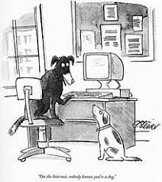
Internet, nobody knows you're a dog ...
en.wikipedia.org
On the Internet, nobody knows you’re a dog!

Slide 2
Lecture 3 The Rise of the Internet
or
“The Triumph of the Nerds”

Slide 3
Factors behind the early development of the Internet
U.S. and Soviet Bloc engaged in a “cold war” escalating after WWII
MAD Doctrine (Mutually Assured Destruction)
The U.S. Govt. did not have an adequate communications network to function effectively in the event of a real nuclear conflict with the USSR
The early funding from DARPA (Defense Advanced Research Projects Agency ) was an attempt to identify technologies that could be employed to create a “resilient” data network that could continue to function in the event of nuclear war

Slide 4
A Very Short History of the Internet
1961-69 Research in distributed communications progresses
1969 Arpanet (Advanced Research Projects Network) is commissioned by the Department of Defense with nodes at UCLA, Stanford Research, UC Santa Barbara and Univ. of Utah…designed as a “best effort” network
1971- 15 nodes operational w/ 23 Systems
1972- Email is introduced
1982- TCP/IP is chosen as the new communications protocol for Arpanet, developed by Vint Cerf and Bob Kahn, the ”fathers” of the internet

Slide 5
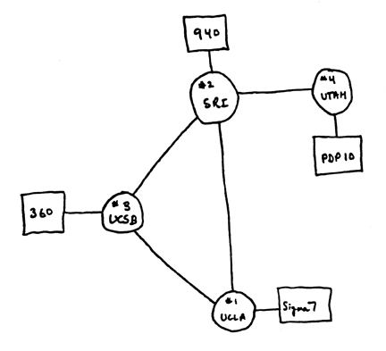
The Original Internet 1969

Slide 6
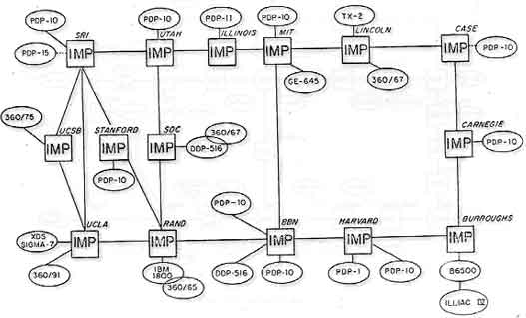
The Internet Circa 1971
Logical map of the ARPANET, April 1971

Slide 7
Earliest Internet Apps
The first application was a crude form of email which enabled researchers located at the various hosts to share text information electronically
This was soon followed by a file transfer application which allowed the sharing of medium sized text files
Next up was the establishment of “bulletin boards” which allowed groups of researchers to post message threads around topics of mutual interest…an early form of “blogging”
Also known as Newsgroups

Slide 8
…very short Internet history
1984- Number of systems reaches 1000
1988- Chat introduced by Jakko Oikarenen
1989- Number of systems reaches 10,000
1990- Arpanet ceases to exist and is now known as the Internet as restrictions on commercial use are dropped by the Govt.
1991- Initial design for the World Wide Web is published by CERN, led by Tim Berners-Lee
1992 Number of systems reaches 1,000,000
1993 Pizza Hut puts up its first website from which you could theoretically order a pizza

Slide 9
..short history continued
1993-White House ( www.whitehouse.gov ) goes on-line
1995-Netscape introduces the first real hypermedia browser as a result of research performed at U. of Minn. (Mosaic)
1996-Microsoft introduces Internet Explorer and the browser wars begin
1997-U.S. Commercial Decency act is passed, and promptly struck down by the Supreme Court as Unconstitutional

Slide 10
…….and Finally!!!!!
2020 -4.2 Billion Active Internet Users !
The Internet Protocol had become the world standard for networks and everything is being connected….computers, cellphones, pda’s, cable boxes, Playstations, cameras, doorbells, alarms, smoke detectors, etc, etc
Probably the 2nd most important invention of the 20th Century!

Slide 11
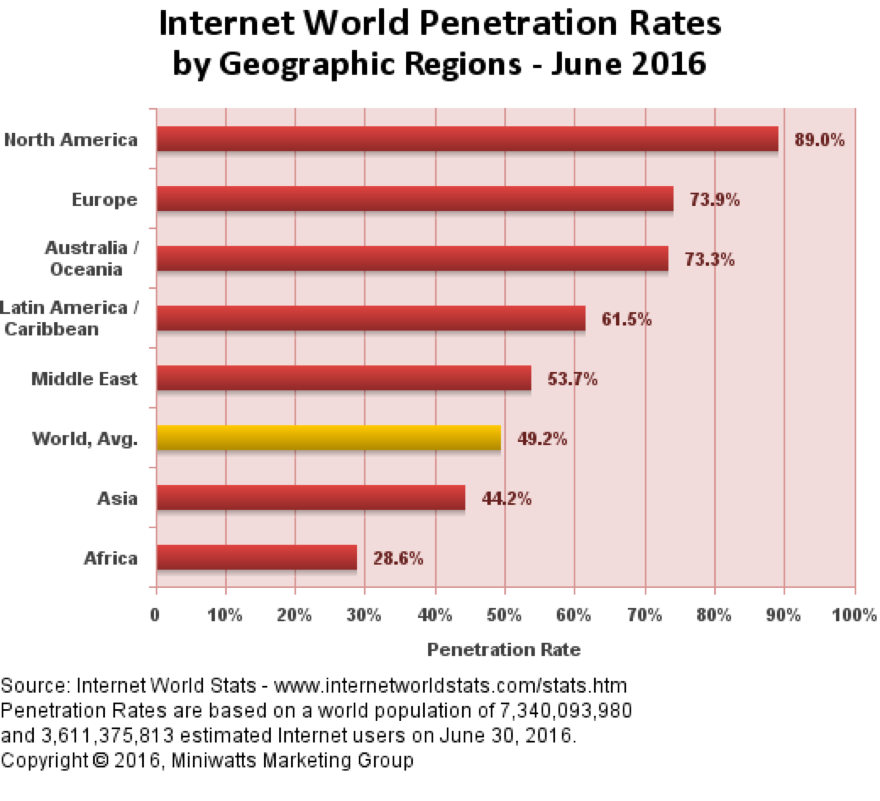
d2021

Slide 12
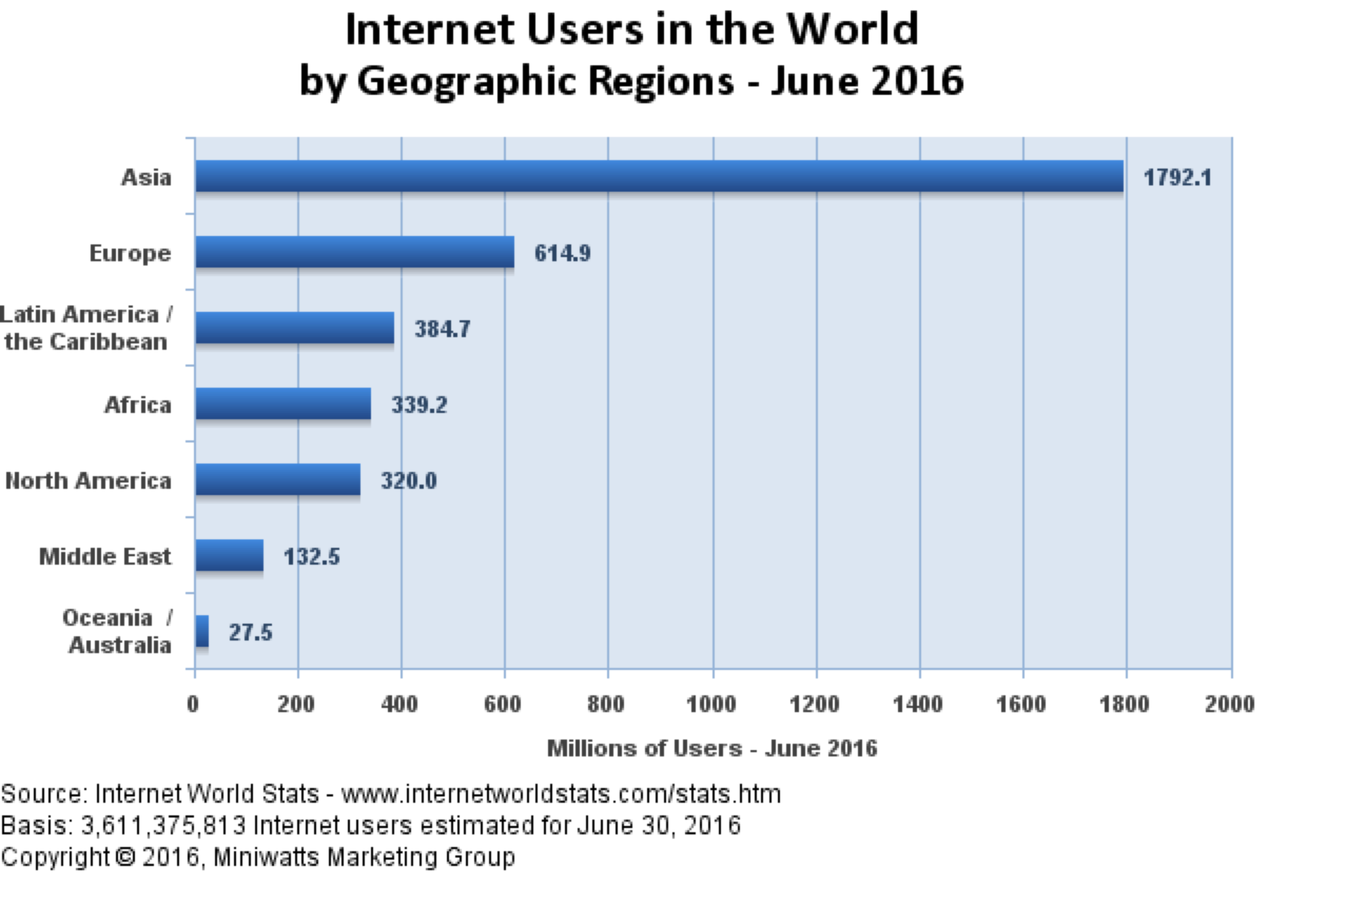

Slide 13
2024 Internet Statistics
There are 5.35 billion internet users worldwide.
The number of internet users is expected to reach 7.9 billion by 2029
On average, internet users spend six and a half hours online every day
As of 2024, 94.6% of Americans have access to the internet
75% of people aged 15 to 24 have access to the internet across the world
5.04 billion people are on social media as of 2024

Slide 14
Domain Statistics as of 9 / 2020
330,000,000 active domains
386,000,000 deleted domains
80,000 domains added in past 24 hours
93,000 domains deleted in past 24 hours
Over 2 Billion registered websites

Slide 15
So….What is the Internet?
a loose confederation of data communication networks
“data communications”: sending digital information from computer to computer
“information highway” connecting far corners of the world
an open, distributed system: no central control

Slide 16
Most Popular Internet Applications
a variety of applications (software) for sending and receiving information
Electronic mail (still numero uno)
File transfers (FTP)
World Wide Web (WWW)
Podcasting and streaming audio
Streaming Video
Instant Messaging (Texting)
Video Conferencing
Voice over IP (VOIP)
Facebook, Google Apps, Twitter, Instagram, Games, and on and on…..

Slide 17
Email Stats
Approximately 170 Billion emails sent every day
70 percents of all emails are spam or infected with worms or viruses
1.1 Billion legitimate senders per day
(One out of every six people)

Slide 18
Origins of the “Web”
Tim Berners-Lee and CERN project (1989)
First ever web page: http://info.cern.ch/hypertext/WWW/TheProject.html
Initially a distributed, hypertext system for disseminating physics and scientific research
Pages based on a markup language that can be shared by different computer systems

Slide 19
World Wide Web
An assortment of computers (web servers) connected by the Internet
employs a common protocol standard
HTTP (hyperText transfer protocol),
basically “Text on Drugs”
Sending and receiving hypermedia documents
Hypertext pioneered at Brown!
http://ei.cs.vt.edu/book/chap1/htx_hist.html

Slide 20
Early Years of the Web
Text-based browsers
Web expands to government agencies and educational community
NCSA introduces a graphical user interface (GUI) browser, Mosaic (1993), followed by Netscape and Internet Explorer
Web becomes the new Internet “killer app”
Performance issues gave the web the name the “World Wide Wait”

Slide 21
Commercialization of the Web
Original ban on commercial sites lifted (1990)
“.com” becomes the most dominant origin designator as opposed to .edu, .gov, .org, .biz, etc;
e-commerce is born: electronic transactions over the Web (and Internet)
Over 1 Billion websites on line today

Slide 22
Organization of the Web
Web clients (browsers) and Web servers
common protocol: HTTP
HyperText Transfer Protocol
(connect, request, send, receive, display)
Naming convention called URLs for identifying resources
HTML (HyperText Markup Language) defines how Web pages are structured

Slide 23
Web Browsers & Servers
Web browsers (clients)
ask for, receive, and display Web documents
Web servers
remote systems that store Web documents
process client requests and send resources

Slide 24
Hypermedia and Hyperlinks
electronic documents containing multimedia information
hyperlinks (“links”) to cross-reference pages and resources
links provide automatic access
hypermedia documents are “navigated” using these links

Slide 25
Going to a Web Site
You are in a web browser and you ask to go to
www.cs.brown.edu/courses/csci0020
(the home page for this course). What happens?
The fast answer is, a page of information is transferred to your computer, which proceeds to display it. The web page comes to you!!!

Slide 26
Fetching & Opening Web Pages
Web browsers ask for pages by their Uniform Resource Locator
http://www.cs.brown.edu/courses/cs002/
path
resources
protocol
URLs provide a convenient and easy to remember naming
For a Web Site as opposed to its actual address
http://192.168.125.1/ for instance

Slide 27
Parts of a URL
http:// This states that we a requesting a page from a remote web server.
www.cs.brown.edu This is the name of the web server. This name must be “registered” with the powers that be.
/courses/cs002 indicates which of the many pages from that server is being requested.

Slide 28
Protocols
There are many protocols that govern how information is transferred on the web. A “protocol” is a convention established to govern the manner in which data traverses a network.
The “http” at the start of the URL stands for “Hypertext transfer protocol,” which is the main such protocol.

Slide 29
Return Addresses
Your request is transferred to the right server because machines along the way (routers) know how to interpret the URL and map it to an address where the web page resides
When it arrives at the correct server, your message includes a “return address” so the server knows where to send the requested page.

Slide 30
What is a Web Server?
A “server” is simply a computer that acts as a utility for other computers. A web server is a server that serves up web pages.
A file server is a computer that returns files requested by users on other computers. (When you request a file from the Brown computer system, you are communicating with a file server.)

Slide 31
When the Information Arrives
When the web page you have requested arrives at your machine, your browser must figure out how to display it.
A browser (like IE6 or Netscape) is a piece of software that, among other things, translates the information received into a screen display.

Slide 32
Search Engines
An internet search engine (like Yahoo or Google) is a program that tries to provide a user with a list of potentially relevant web sites based upon (typically) a few key words provided by the user.
The actual “search” is being done by a server (in this case a computer belonging to the search engine company).

Slide 33
Search Engine Communication
To initiate a search your browser sends your keywords to the server.
The server tries to match them against an index of key words along with addresses of possible web sites. The URLs for the web sites are then sent back to your machine.
The differences between search engines are their indexing and matching methods.

Slide 34
How Does it Work?
The short, short summary is that Google (and other search engines) continuously crawl the web, using a program called a spider or crawler.
It stores a local copy of the pages it finds, and builds a lexicon of common words. For each word, it creates a list of pages that contain that word.
A query for a given word returns that list, sorted by pagerank. Pagerank is computed based on the pageranks of the pages linking to a document.

Slide 35
Making money on searches
Google has become one of the most highly valued public companies in the world due to it’s popularity and its ability to get advertisers to bid on page ranking in order to feature their web links

Slide 36
Evaluating Content on the Web
The web is an anarchist’s heaven. There is little accountability for anything published there; for example:
No censorship
Accuracy of unverified information is always an issue since it is easy to remain anonymous
Much of the content is “rushed” into print
Information (true and false) on practically everything can be found there however and it is constantly evolving and being updated

Slide 37
In short,
If you read something in an email or on the web that sounds too good to be true,
It very probably is….
www.snopes.com is a good website for checking out internet scams and other urban legends

Slide 38
Millionaire Quiz Game!

Slide 39
Organization of the Internet

Slide 40
TCP/IP
Messages on the internet are standardized using two protocols:
TCP (Transfer Control Protocol) breaks messages up into small chunks.
IP (Internet Protocol) specifies how messages are addressed and routed.

Slide 41
TCP
Messages are broken up into packets of a fixed size and sent out on the internet.
These messages may be received in an order different from that in which they were sent.
Each packet contains a destination address
Individual packets may also be lost.
TCP may request packets to be resent, and finally it puts the packets back in order.

Slide 42
IP
The Internet Protocol governs addressing and routing.
An IP address is 4 numbers, each less than 256. For example, 156.222.111.255
The routers on the web know how to interpret IP addresses and send the packets to the correct destination.
IP packets are also known as DATAGRAMS

Slide 43
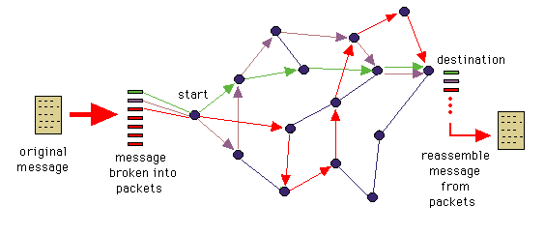
The Internet uses Packet Switching
In packet switching, the message is broken up into separate data packets each addressed to the destination
Packets are transmitted over any available connection to the destination, where the receiving node reassembles the message

Slide 44
Packet Errors
The Internet was designed to be a “best effort” network when it was conceived
Performance, Security and Reliability enhancements have been band aids on top of the original, simple design
Approximately 1-3 % of ALL packets sent over the Internet get lost and have to be re-transmitted

Slide 45
Domain Names
Domain names are more intuitive names for IP addresses.
The name cs.brown.edu is the domain name for the Brown computer science home page.
How is the connection made between the domain name and the IP address?

Slide 46
Domain Name Servers
To some degree the process is distributed. That is, Brown provides a name server for all domain names that end in brown.edu.
But how does the internet find the address of this name server?
There are top level name servers for each of the domains .com, .edu, etc.

Slide 47
Top Level Domain Name Servers
When someone registers a .com domain name for instance, the registering company forwards this information to Network Solutions, the company that runs the primary top level domain name server for .com addresses.
They add this information to the name server that they run.

Slide 48
Secondary Top Level Servers
Within 48 hours of the entry into the Network Solutions machine this information is copied over into several other top level servers.
This relieves traffic on any one, and makes sure that one machine going down will not cripple the internet.

Slide 49
Caching Servers
Caching servers are located at locations where there is a high degree of activity
They maintain copies of the most frequently accessed web pages so that they can be retrieved “locally” instead of having to go over the internet for each access
This works for those web pages that don’t change very often
Most large businesses and institutions have local caching servers
Increases performance and reduces traffic

Slide 50
How to Get Your Own .Com
Go to a domain registry like Go Daddy!
Register a unique name that is not already in use!
These days you can register a domain name for about $25/year.

Slide 51
Space…the Final Frontier
The Internet was designed to accommodate about 4 Billion unique addresses using the current address numbering scheme
Over 3.2 Billion addresses are already in use
Today, most domains and Internet Service Providers maintain tables of sub-addresses which are assigned to users when they connect in order to conserve addresses
This is very complicated and inefficient
Ideally, everyone and every device would have a unique address

Slide 52
IPV6 has the answer!
Internet protocol Version 6 has been implemented which offers
340,282,366,920,938,463,463,374,607,431,768,211,456
addresses
4 billion X 4 billion X 4 billion X 4 billion
How many is that?

Slide 53
Why is that important?
When fully implemented, everyone on the planet and every device that they own could have a unique internet address
Computers, PDAs, Cellphones, Media Players, Wrist watches, Appliances, Televisions, Radios, Automobiles…the list goes on…

Slide 54
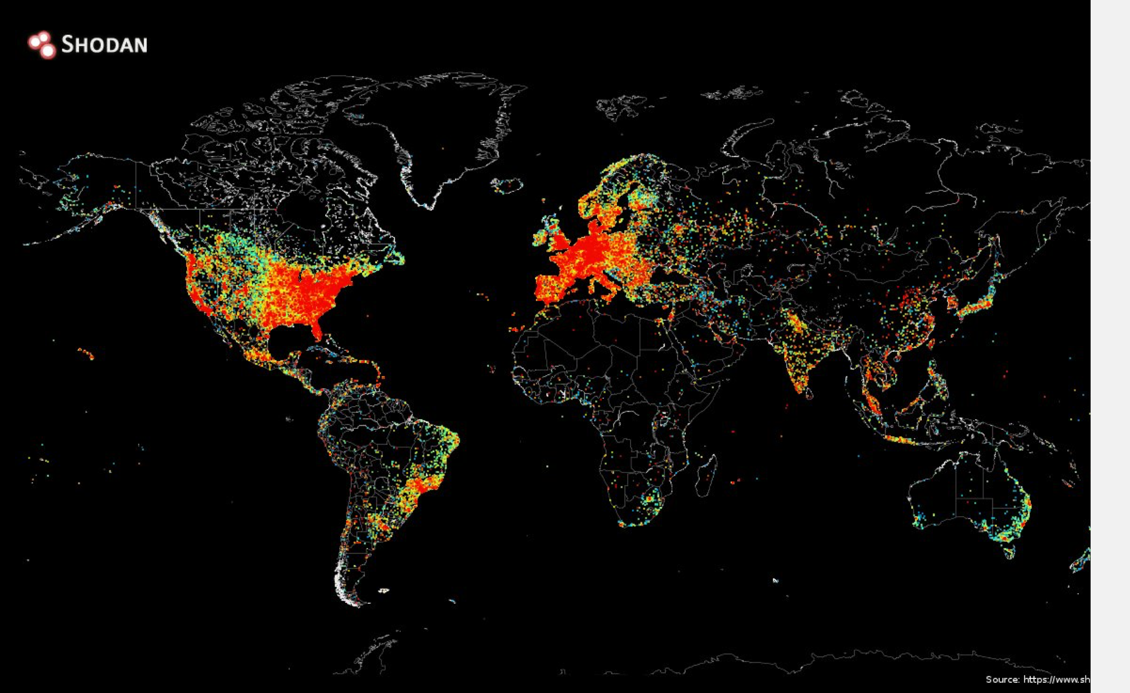
Distribution of Devices Connected to the Internet

Slide 55
Information Overload!
the world's total yearly production of print, film, optical, and magnetic content would require roughly 1.5 billion gigabytes of storage. This is the equivalent of 250 megabytes per person for each man, woman, and child on earth

Slide 56
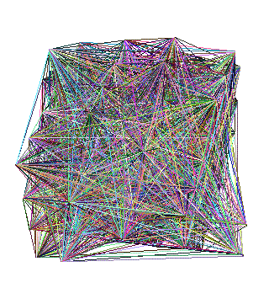
What a physical model of it might look like

Slide 57
Security Issues
The widespread adoption of the Internet and the Web and Email in particular, have made the net the breeding ground for many types of illicit or undesirable activities:
Computer Viruses, Trojans and Worms
Financial Fraud and Identity Theft
Crimes against seniors, minors
Anonymous Libel
State sponsored Cyber warfare

Slide 58
The Impact of the Internet
Very few technological advances have impacted the planet as quickly and as completely as the development of the Internet
No one involved in the early development would have envisaged the level of adoption or the range of services that today we take for granted.
The Net continues to grow and evolve.

Slide 59
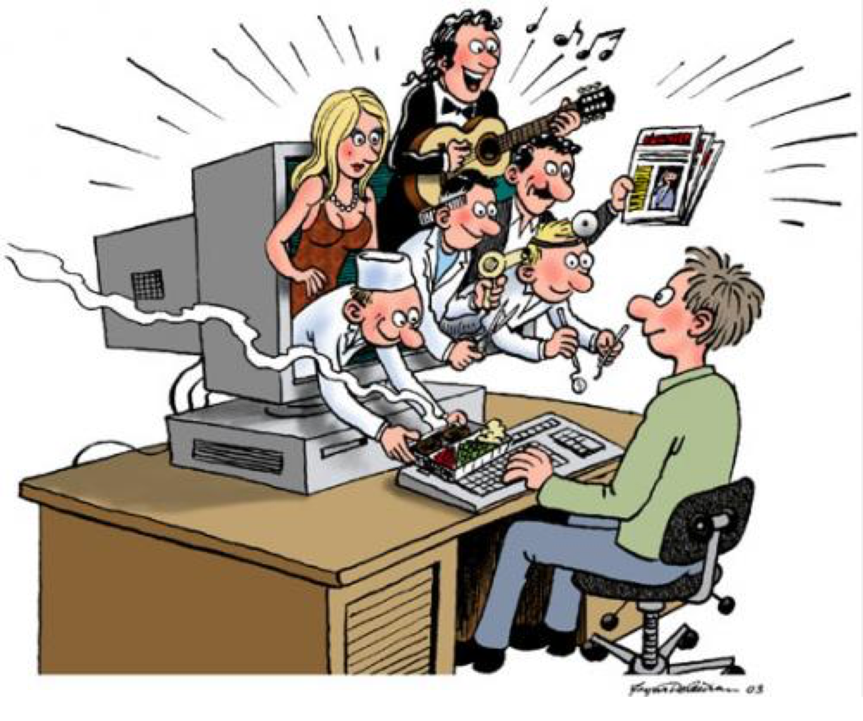

Slide 60
Questions?

